Slide 1
Profit & Growth Analysis – Kakuma Business Dataset
Name: Aluong Yak Kon

Slide 2
Project Objective
Understand revenue and profit trends
Identify high performing products
Detect risks and low performing areas
Recommend actions for business growth

Slide 3
Dataset Overview
Number of records
Key variables (Product, Revenue, Profit, Payment Method, Month)

Slide 4
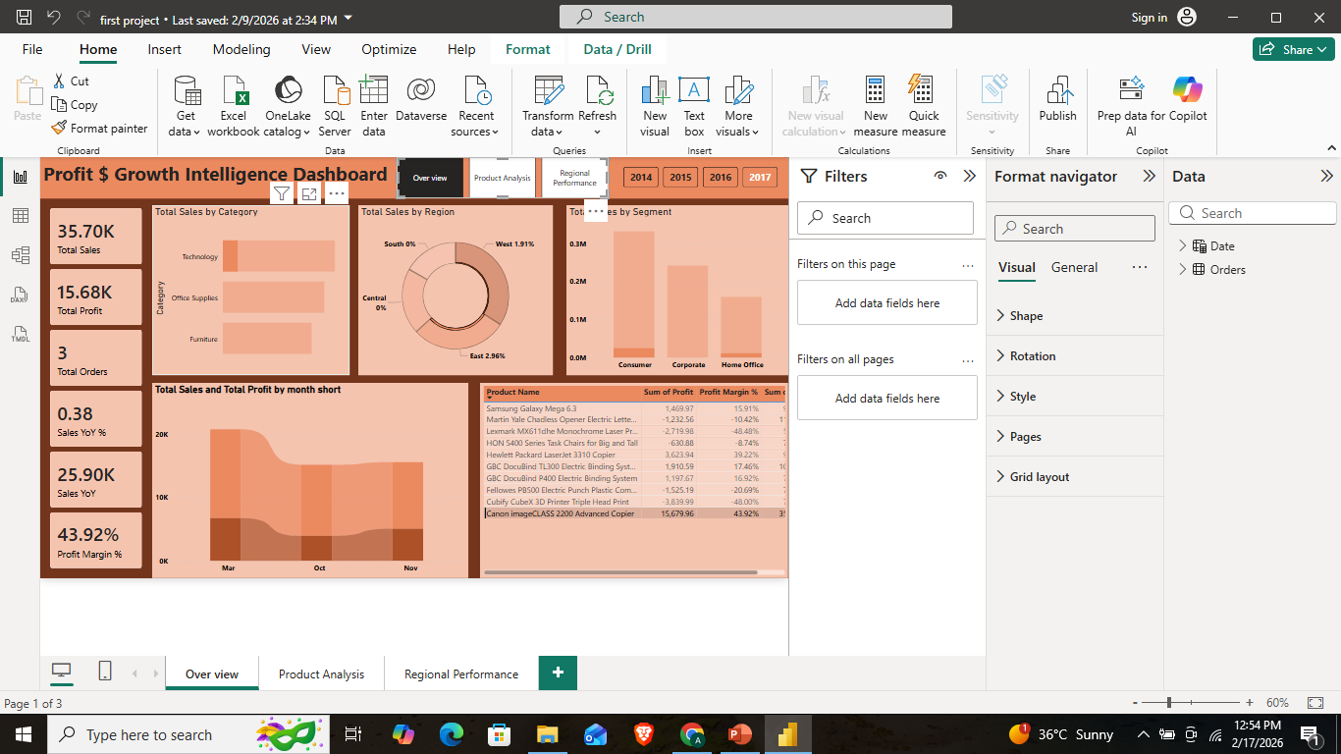
Revenue Insights
Which products generate highest revenue
Seasonal trends

Slide 5
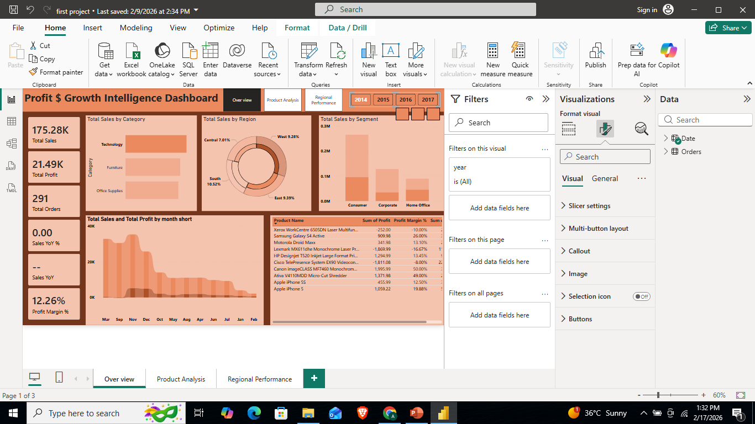
Profit Insights
Which products are most profitable
Technology
Which products generate losses
Furniture

Slide 6
Growth Trends
Monthly growth patterns
Peak and low months

Slide 7
Customer / Payment Insights
Most used payment methods
Payment trends over time

Slide 8
What to GROW
High profit + high demand products
Strong performing months
Successful payment channels

Slide 9
WHAT TO FIX
Low margin products
Declining monthly sales
Inefficient pricing

Slide 10
WHAT TO STOP
Consistently loss-making products
Low-performing channels
Non-profitable strategies

Slide 11
Key Recommendations
Increase inventory of high-performing products
Improve pricing strategy
Reduce cost of low-margin items

